Slide 1
Bright Network Technology Academy
Framework for Onboarding and Ongoing Support
May 2022

Slide 2
Version Control Systems
What, why, how?
May 2022

Slide 3
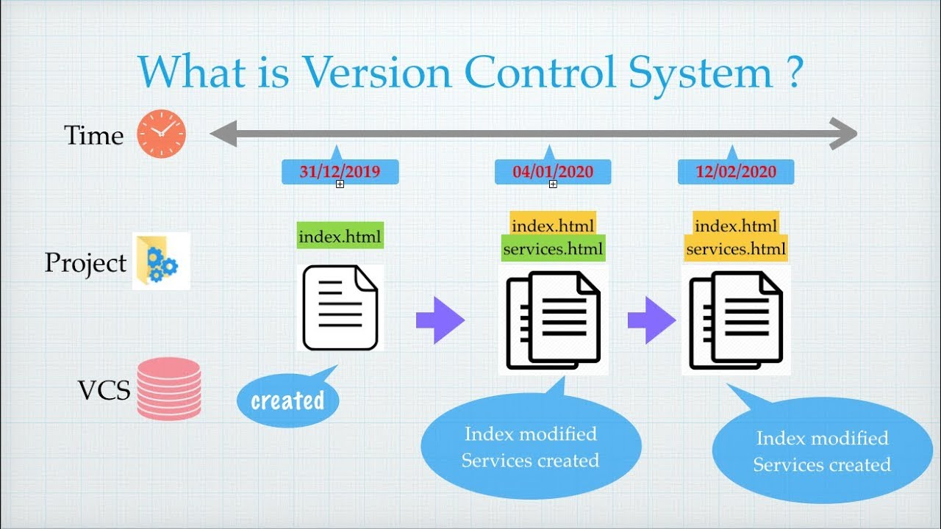
What is Version Control?
Version control, also known as source control, is the practice of tracking and managing changes to files.
Version control systems are software tools that help software teams manage changes to files over time.
Notes:
Version control is a system that records changes to a file or set of files over time so that you can recall specific versions later. It allows you to revert selected files back to a previous state, revert the entire project back to a previous state, compare changes over time, see who last modified something that might be causing a problem, who introduced an issue and when, and more. Using a VCS also generally means that if you screw things up or lose files, you can easily recover. In addition, you get all this for very little overhead.

Slide 4
Concepts of Version Control

Slide 5
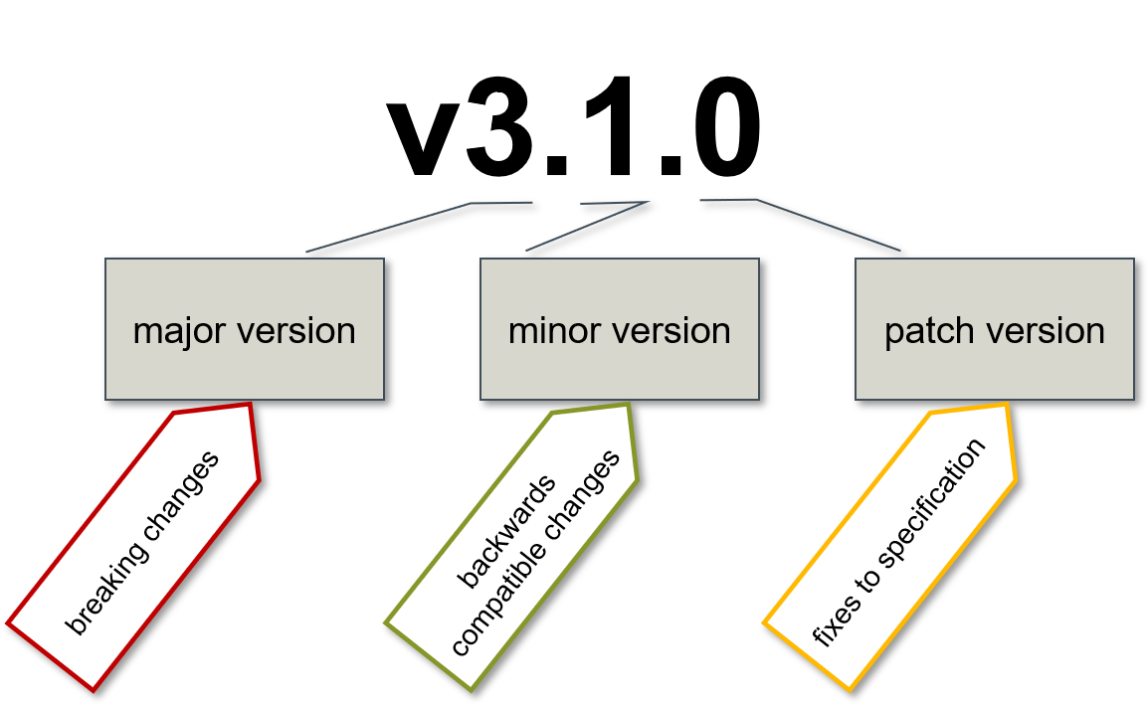
Concepts of Version Control
Versioning
Software versioning is the process of numbering different releases of a particular software program
Semantic Versioning
Notes:
Software versioning is the process of numbering different releases of a particular software program for both internal use and release designation. It allows programmers to know when changes have been made and track changes enforced in the software. At the same time, it enables potential customers to be acquainted with new releases and recognize the updated versions.
SemVer
Given a version number MAJOR.MINOR.PATCH, increment the:
MAJOR version when you make incompatible API changes,
MINOR version when you add functionality in a backwards compatible manner, and
PATCH version when you make backwards compatible bug fixes.
Additional labels for pre-release and build metadata are available as extensions to the MAJOR.MINOR.PATCH format.

Slide 6
Concepts of Version Control
Versioning
Software versioning is the process of numbering different releases of a particular software program
Allows programmers to know when changes have been made and track changes enforced in the software
Semantic Versioning
Notes:
Software versioning is the process of numbering different releases of a particular software program for both internal use and release designation. It allows programmers to know when changes have been made and track changes enforced in the software. At the same time, it enables potential customers to be acquainted with new releases and recognize the updated versions.

Slide 7
Concepts of Version Control
Versioning
Software versioning is the process of numbering different releases of a particular software program
Allows programmers to know when changes have been made and track changes enforced in the software
Enables potential customers to be acquainted with new releases and recognise the updated versions
Semantic Versioning
Notes:
Software versioning is the process of numbering different releases of a particular software program for both internal use and release designation. It allows programmers to know when changes have been made and track changes enforced in the software. At the same time, it enables potential customers to be acquainted with new releases and recognize the updated versions.

Slide 8
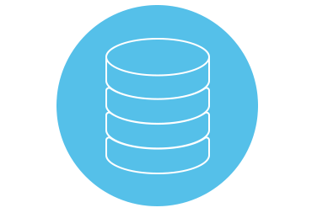
Concepts of Version Control
Repository
Defined place where all the developers or programmers work and store their code

Slide 9
Concepts of Version Control
Repository
Defined place where all the developers or programmers work and store their code
Repositories also maintain the history

Slide 10
Concepts of Version Control
Repository
Working Copy
Defined place where all the developers or programmers work and store their code
Repositories also maintain the history
The user’s copy of the repository

Slide 11
Types of Version Control Systems

Slide 12
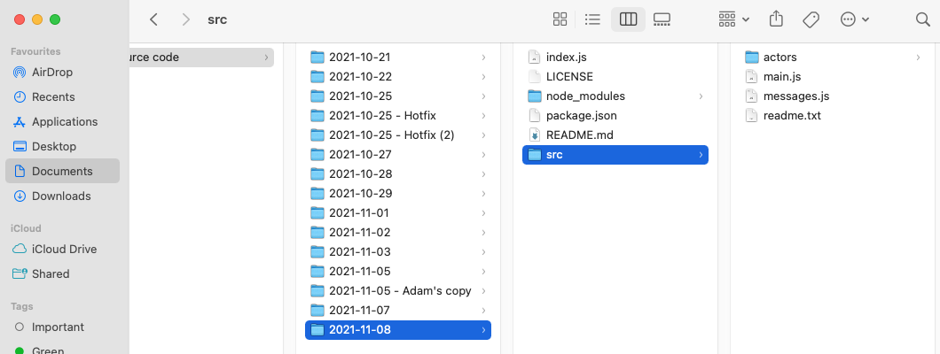
Types of Version Control Systems
DIY (folders)
Versions of files using a series of folders as a common way to maintain a history of changes over time.
Pros
Common
Simple
Cons
Error prone
Difficult to use with multiple users
Duplication of files
Notes:
DIY version control
Many people’s version-control method of choice is to copy files into another directory (perhaps a time-stamped directory, if they’re clever).
It is easy to forget which directory you’re in and accidentally write to the wrong file or copy over files you don’t mean to.
Duplication of files (e.g. node_modules in the example shown) can be overcome using e.g. symlinks but it becomes inefficient and fragile
To deal with this issue, programmers long ago developed local VCSs that had a simple database that kept all the changes to files under revision control.

Slide 13
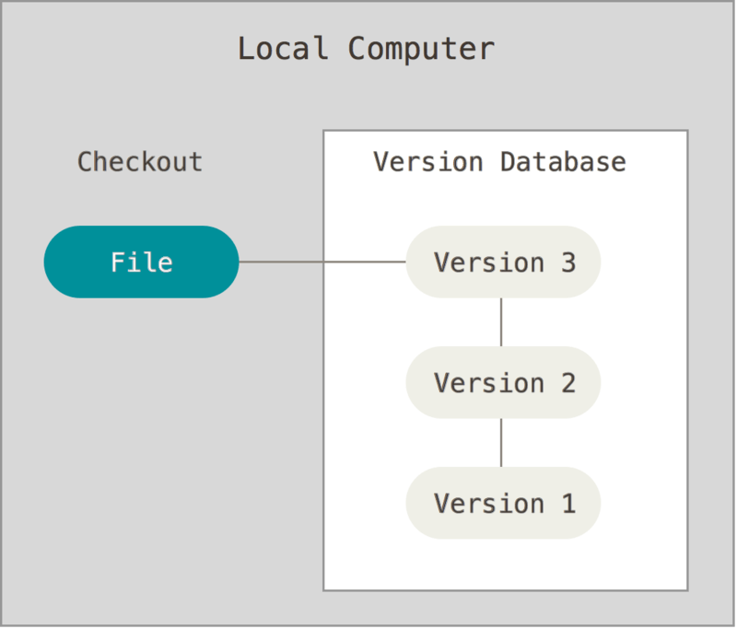
Types of Version Control Systems
Local Version Control Systems
Maintains track of files within the local system
Pros
Faster than save revisions to a remote server
Common and simple approach
Cons
Fragile
Difficult to use with multiple users
Source: https://git-scm.com/book/en/v2/Getting-Started-About-Version-Control
Notes:
Local Version Control Systems
Actual example local version control system - Microsoft Visual SourceSafe
Fragile
Storage of the repository on local file system is risking catastrophic data loss
Location of the repository on a shared network folder enables multi-user access but introduces fragility due to contention and concurrency problems with multiple users accessing the same complex file system

Slide 14
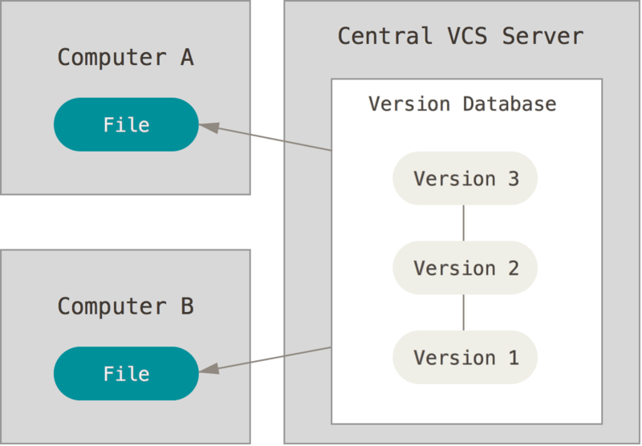
Types of Version Control Systems
Centralised Version Control
All the changes in the files are tracked on a centralised server
The centralised server includes all the information of versioned files, and list of clients that check out files from that central place
Pros
Allows collaboration with developers on other systems
Cons
Single point of failure
Source: https://git-scm.com/book/en/v2/Getting-Started-About-Version-Control
Notes:
Centralized Version Control Systems
collaborate with developers on other systems. To deal with this problem, Centralized Version Control Systems (CVCSs) were developed.
Examples: CVS, Subversion, and Perforce - a single server that contains all the versioned files, and a number of clients that check out files from that central place. For many years, this has been the standard for version control.
everyone knows to a certain degree what everyone else on the project is doing
Administrators have fine-grained control over who can do what, and it’s far easier to administer a CVCS than it is to deal with local databases on every client or shared folder
BUT
single point of failure that the centralized server represents
If that server goes down for an hour, then during that hour nobody can collaborate at all or save versioned changes to anything they’re working on
If the hard disk the central database is on becomes corrupted, and proper backups haven’t been kept, you lose absolutely everything — the entire history of the project except whatever single snapshots people happen to have on their local machines (just like local VCS)

Slide 15
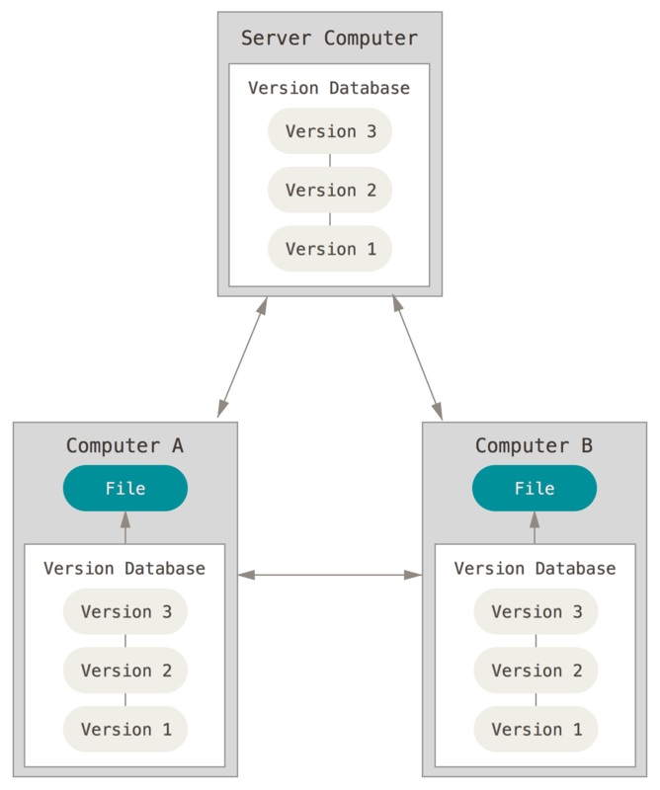
Types of Version Control Systems
Distributed Version Control
The clients completely clone the repository including its full history
Pros
Every clone is considered as a full backup of all the data
Cons
Mental model requires adjustment
Complexity should be controlled
Source: https://git-scm.com/book/en/v2/Getting-Started-About-Version-Control
Notes:
Distributed Version Control Systems
Examples: Git, Mercurial, Bazaar or Darcs
Clients fully mirror the repository, including its full history.
Every clone is really a full backup of all the data.
Also:
In theory changes can be exchanged between e.g. Computer A and Computer B in the diagram shown. In practice people usually exchange updates with a central repository, but the facility is useful in certain situations
Furthermore, many of these systems deal pretty well with having several remote repositories they can work with, so you can collaborate with different groups of people in different ways simultaneously within the same project. This allows you to set up several types of workflows that aren’t possible in centralized systems, such as hierarchical models.
BUT:
Mental model requires adjustment from a centralised mindset
It’s possible to create really complex, confusing workflows if you’re not careful
BONUS:
“Monorepos” exist (e.g. Google) where multiple code streams reside in a single DCVS repository (and single branch). This means that clones MAY NOT be a “full backup” but instead are a full backup of the state of a single portion of the repository.

Slide 16
The benefits of Version Control

Slide 17

Benefits of Version Control
Collaboration
With a VCS, everybody on the team is able to work absolutely freely - on any file at any time. The VCS will later allow you to merge all the changes into a common version.
Notes:
Collaboration
Without a VCS in place, you are probably working together in a shared folder on the same set of files. Shouting through the office that you are currently working on file "xyz" and that, meanwhile, your teammates should keep their fingers off is not an acceptable workflow. It's extremely error-prone as you're essentially doing open-heart surgery all the time: sooner or later, someone will overwrite someone else's changes.
With a VCS, everybody on the team is able to work absolutely freely - on any file at any time. The VCS will later allow you to merge all the changes into a common version. There's no question where the latest version of a file or the whole project is. It's in a common, central place: your version control system.

Slide 18

Benefits of Version Control
Storing Versions
Saving a version of your project after making changes is an essential habit.
Notes:
Storing Versions
Saving a version of your project after making changes is an essential habit. But without a VCS, this becomes tedious and confusing very quickly:
How much do you save? Only the changed files or the complete project? In the first case, you'll have a hard time viewing the complete project at any point in time - in the latter case, you'll have huge amounts of unnecessary data lying on your hard drive.
How do you name these versions? If you're a very organized person, you might be able to stick to an actually comprehensible naming scheme (if you're happy with "acme-inc-redesign-2013-11-12-v23"). However, as soon as it comes to variants (say, you need to prepare one version with the header area and one without it), chances are good you'll eventually lose track.
The most important question, however, is probably this one: How do you know what exactly is different in these versions? Very few people actually take the time to carefully document each important change and include this in a README file in the project folder.
A version control system acknowledges that there is only one project. Therefore, there's only the one version on your disk that you're currently working on. Everything else - all the past versions and variants - are neatly packed up inside the VCS. When you need it, you can request any version at any time and you'll have a snapshot of the complete project right at hand.

Slide 19

Benefits of Version Control
Restoring Previous Versions
With a VCS you can go back to any previous version. This implies that if you make a mistake it can be easily fixed by rolling back.
Notes:
Restoring Previous Versions
With a VCS you can go back to any previous version. This implies that if you make a mistake it can be easily fixed by rolling back. Also, it is easy to see how the project was evolving over time.
Being able to restore older versions of a file (or even the whole project) effectively means one thing: you can't mess up! If the changes you've made lately prove to be garbage, you can simply undo them in a few clicks. Knowing this should make you a lot more relaxed when working on important bits of a project.

Slide 20

Benefits of Version Control
Understanding What Happened
Everytime you make a change in a VCS generating a new version you need to write a small comment saying what changed and why.
Notes:
Understanding What Happened
Every time you save a new version of your project, your VCS requires you to provide a short description of what was changed. Additionally (if it's a code / text file), you can see what exactly was changed in the file's content. This helps you understand how your project evolved between versions. Eg with Git you can see the changes line by line.
Backup
A side-effect of using a distributed VCS like Git is that it can act as a backup; every team member has a full-blown version of the project on his disk - including the project's complete history. Should your beloved central server break down (and your backup drives fail), all you need for recovery is one of your teammates' local Git repository.

Slide 21

Benefits of Version Control
Backup
Using a distributed VCS like Git every member of the team has a copy of the whole repository* which can serve as backup.
* For monorepos - a full history of a portion of the whole repository.

Slide 22
Benefits of VCS to
Configuration Management

Slide 23

Benefits of VCS to Configuration Management
Single Source of Truth
Manual infrastructure management can result in discrepancies. Configuration Management solves this by having the config files themselves be the single source of truth.

Slide 24

Benefits of VCS to Configuration Management
No snowflake environments
All servers are configured exactly the same, no snowflake servers anymore.

Slide 25

Benefits of VCS to Configuration Management
Much faster recovery times
By putting the configuration under source control and enforcing that the configuration can only be deployed from it (rather than on an ad-hoc basis), you can be confident that you can recreate the environment correctly and quickly.

Slide 26

Benefits of VCS to Configuration Management
All changes are tracked, governance satisfied
By putting the configuration under source control, all changes are committed and are tagged with the user ID of the person who made the change.

Slide 27
Benefits of VCS to Configuration Management
All changes are tracked, governance satisfied
By putting the configuration under source control, all changes are committed and are tagged with the user ID of the person who made the change.
Quite often, there are governance requirements that restrict developer access to production environments.
Notes:
Example “stored securely as part of pipeline configuration” - GitHub secrets

Slide 28
How Do We Do It?

Slide 29


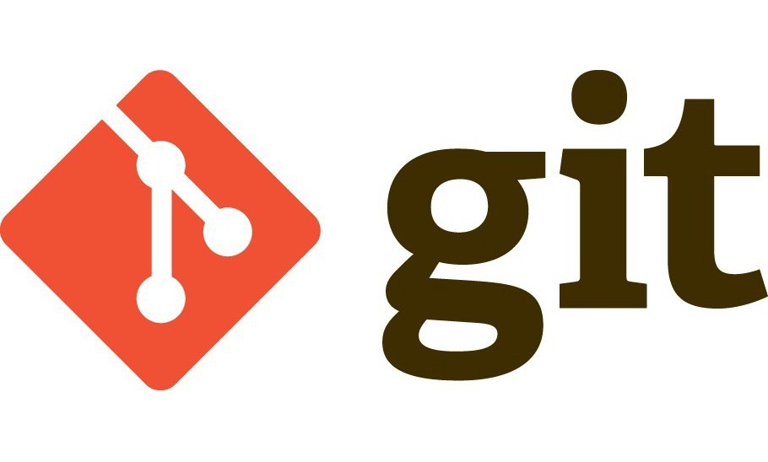


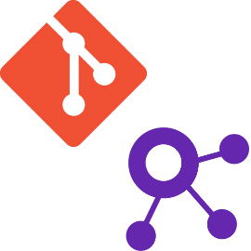
How Do We Do It?
Version Control Tools
Centralised
Distributed
TFVC

Slide 30
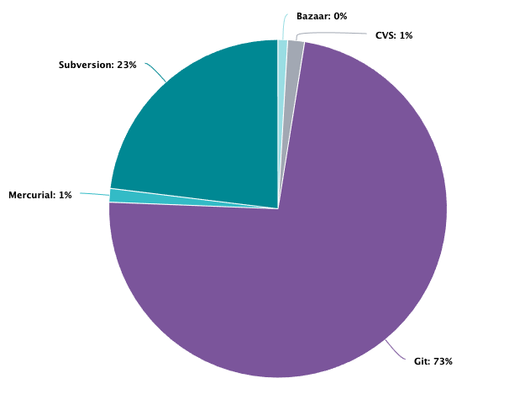
How Do We Do It?
Git - one VCS to rule them all
Notes:
https://www.openhub.net/repositories/compare

Slide 31
How Do We Do It?
Git
Git is a free and open source distributed version control system
Notes:
We are going to use Git as our version control tool.
Having a distributed architecture, Git is an example of a DVCS (hence Distributed Version Control System). Rather than have only one single place for the full version history of the software as is common in once-popular version control systems like CVS or Subversion (also known as SVN), in Git, every developer's working copy of the code is also a repository that can contain the full history of all changes.

Slide 32
How Do We Do It?
Git
Git is a free and open source distributed version control system
Handles everything from small to very large projects with speed and efficiency

Slide 33
How Do We Do It?
Git
Git is a free and open source distributed version control system
Handles everything from small to very large projects with speed and efficiency
Authentic content history of your source code.
Notes:
Authentic content history of your source code.
Git has been designed with the integrity of managed source code as a top priority. The content of the files as well as the true relationships between files and directories, versions, tags and commits, all of these objects in the Git repository are secured with a cryptographically secure hashing algorithm called SHA1. This protects the code and the change history against both accidental and malicious change and ensures that the history is fully traceable.

Slide 34
VCS Landscape in 2021
Notes:
https://www.openhub.net/repositories/compare
And the winner is…
We’ll touch on some elements of some other VCS tools/systems, but our focus today will be Git

Slide 35
Repository Hosting Services

Slide 36
Repository Hosting Services
The difference between a repository hosting services and a version control system
Version control systems are the low level file and metadata manipulation tools that are used to manage the software development life cycle changes to a collection of source code files
Notes:
So we talked about the tools - but our VCS system needs to store (all the versions) of our files somewhere...

Slide 37
Repository Hosting Services
The difference between a repository hosting services and a version control system
Version control systems are the low level file and metadata manipulation tools that are used to manage the software development life cycle changes to a collection of source code files
Repository hosting services are network and/or web applications that wrap and enhance a version control system
Notes:
Unless local, there needs to be a server (or virtual service somewhere)
GitHub - BitBucket? GitLab?
Google Cloud Source Repositories, AWS CodeCommit, Azure DevOps Services
For e.g. privacy/control you can have git (or Hg or SVN) repos hosted on-prem
Hybrid approaches offer on-prem and/or cloud versions such as:
GitHub Enterprise
Bitbucket in the enterprise
Azure DevOps Server

Slide 38
Repository Hosting Services
The difference between a repository hosting services and a version control system
Version control systems are the low level file and metadata manipulation tools that are used to manage the software development life cycle changes to a collection of source code files
Repository hosting services are network and/or web applications that wrap and enhance a version control system
You cannot fully utilise a repository hosting service without using an underlying version control system
Notes:
Unless local, there needs to be a server (or virtual service somewhere)
GitHub - BitBucket? GitLab?
Google Cloud Source Repositories, AWS CodeCommit, Azure DevOps Services
For e.g. privacy/control you can have git (or Hg or SVN) repos hosted on-prem
Hybrid approaches offer on-prem and/or cloud versions such as:
GitHub Enterprise
Bitbucket in the enterprise
Azure DevOps Server

Slide 39
Repository Hosting Services
Factors to consider when choosing a Repository Hosting Service
Supported version control systems
Team size and access control
Release schedule
Project size and data storage
External tools and 3rd party integrations
Notes:
Supported version control systems
Is the repository hosting service compatible with the version control system in use on the project? This is a critical element to consider. If your project is using Git and the repository service doesn’t offer Git support, it would be very challenging to use that repository hosting service.
Team size and access control
Consider the project’s team structure and working dynamic. Is this a one man operation or a team project? Is this a remote team? Is the team all onsite in the same location? What level of access do team members need to the repository hosting service?
Release schedule
Will there be frequent small updates or larger smaller periodic releases? Many repository hosting services offer CI/CD add-on tools. Additionally the repository service may offer issue tracking and release management tools.
Project size and data storage
Is the project going to be dealing with large binary data files such as 3D modeling graphics or Audio files? There are special repository softwares that specialize in making large files easier to work with. What is the ongoing volume of commits that will happen on the project? Is it an established project with a long history that can take some time to download?
External tools and 3rd party integrations
A key feature of a repository hosting service is the integration of external tools and services. These integrations really enable the power user workflows of a repository service. Some examples of common external integrations are: ticketing and task management. Customer support management tools. Automated quality assurance tools. If your team is already using a particular tool, ensure the code repository integrates with it well.

Slide 40
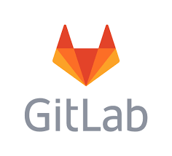

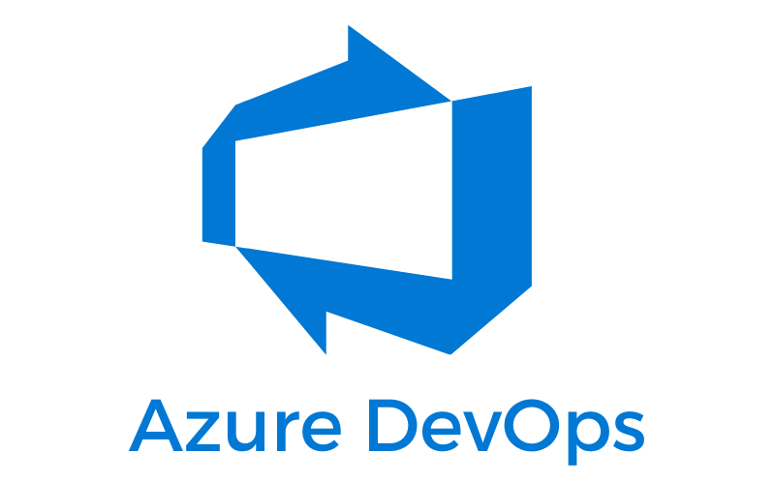
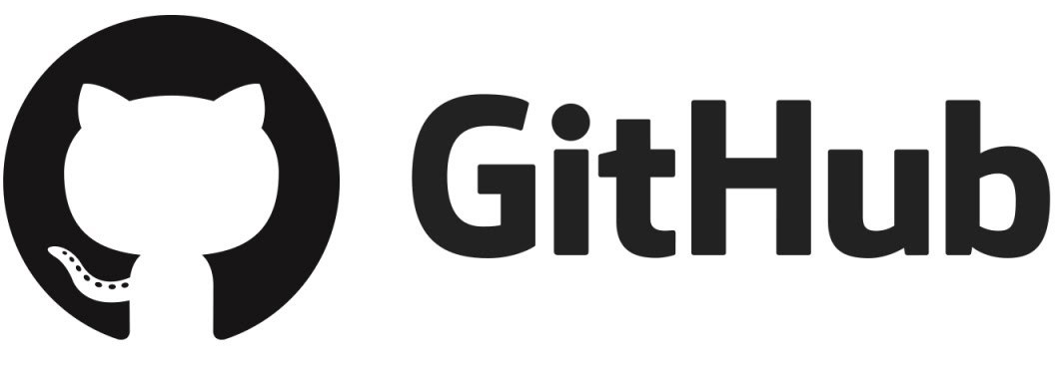
Popular Repository Hosting Services
Notes:
GitHub, GitLab and BitBucket are all Git based repository hosting services. (and GH supports SVN, BB supports Hg, there are plugins for Hg to use a git repo…)
ADO is TFS based but has support for Git
https://docs.github.com/en/enterprise-server@3.0/admin/installation
Installing GitHub Enterprise
System administrators and operations and security specialists can install GitHub Enterprise Server.
For more information, or to purchase GitHub Enterprise, see GitHub Enterprise.
You can request a trial to evaluate GitHub Enterprise Server. For more information, see "Setting up a trial of GitHub Enterprise Server."
If you have questions about the installation process, see "Working with GitHub Enterprise Support."
Setting up a GitHub Enterprise Server instance
Installing GitHub Enterprise Server on AWS
Installing GitHub Enterprise Server on Azure
Installing GitHub Enterprise Server on Google Cloud Platform
Installing GitHub Enterprise Server on Hyper-V
Installing GitHub Enterprise Server on OpenStack KVM
Installing GitHub Enterprise Server on VMware
Installing GitHub Enterprise Server on XenServer
Setting up a staging instance

Slide 41
Git Workflows
Notes:
https://zepel.io/blog/5-git-workflows-to-improve-development/

Slide 42

Git Workflows
Git is the most commonly used version control system today. A Git workflow is a recipe or recommendation for how to use Git to accomplish work in a consistent and productive manner.
Notes:
https://www.atlassian.com/git/tutorials/comparing-workflows
Git is really powerful - and has a huge amount of flexibility - it is not the simple check-out and lock, then check-in and unlock of VisualSourceSafe (for the grey-haired amongst you)
So like anything that is feature rich and really flexible, there are many ways to use it effectively, and many many more to use it badly.
There are a few conventional schemes or paradigms that have emerged - known as Git workflows

Slide 43
Git Workflows
Git is the most commonly used version control system today. A Git workflow is a recipe or recommendation for how to use Git to accomplish work in a consistent and productive manner.
Git workflows encourage developers and DevOps teams to leverage Git effectively and consistently.
Notes:
You can think about it like loading a dishwasher - if different people have different ways to load a dishwasher, and each put some of the dishes in their different way, you’ll probably have some angst, an inefficiently loaded dishwasher, and some dirty dishes :-) It probably matters more that a consistent mechanism is used, than the advantages of one system over another…
That said, there are advantages and disadvantages to the way you load a dishwasher - some prefer the plates facing-in, others all the same way, and a roasting pan might work best if the rack above it is left empty. Every team is different too, so a particular approach/workflow may be better for some teams than others.

Slide 44

Git Workflows
Trunk-based development
It is a version control management practice where developers merge small, frequent updates to a core “trunk” or master/main branch. It’s a common practice among DevOps teams and part of the DevOps lifecycle since it streamlines merging and integration phases. Sources such as Atlassian claim that “trunk-based development is a required practice of CI/CD.”^{[1]}
[1] - ATLASSIAN CI/CD: Trunk-based development
Notes:
https://www.atlassian.com/continuous-delivery/continuous-integration/trunk-based-development
While Atlassian claim this, in fact other branching strategies can be used to achieve CI/CD and have been used that way for years. Trunk based development is simply the preferred method.
Our generic, ideal recommendation - minimises the use of branches, multiple variants of code, and need to (and issues from) merging. Works best when the bigger software process is fast - from start of change through test, build, test, review, test, package, test, deployment, test, release, test - is really short.
However, if your bigger change process has delays in it - you may need to (reluctantly) use branches.
What if someone interrupts saying:
“Surely you can have CI/CD and branches - in fact, I can’t see how you. could operate in our environment without them.”
An answer might be:
“Developers can create short-lived branches with a few small commits compared to other long-lived feature branching strategies. As codebase complexity and team size grow, trunk-based development helps keep production releases flowing.”
Allows to get into the discussion of why branches are bad, etc…. But also acknowledge that there are times that a branch is needed (though granted that branch would fall outside CI - e.g. an experiment PoC to be demo’ed and killed)

Slide 45
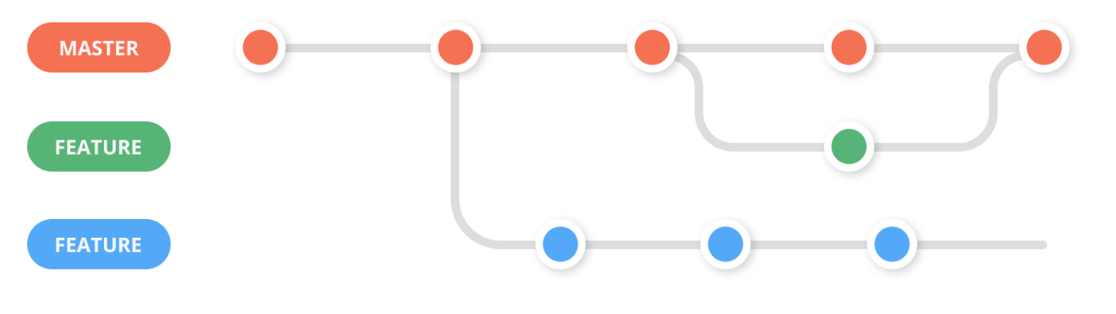
Git Workflows
Feature branch
The Feature Branch Workflow assumes a central repository, and master/main represents the official project history. Instead of committing directly on their local master/main branch, developers create a new branch every time they start work on a new feature.
Notes:
https://www.atlassian.com/git/tutorials/comparing-workflows/feature-branch-workflow

Slide 46
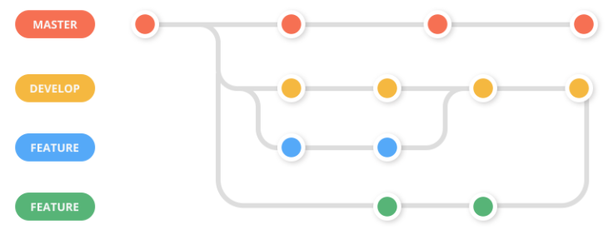
Git Workflows
Feature workflow with develop branch
The develop branch reflects the state with the latest development changes for the next release. Developers create branches from the develop branch and work on new features. Once the feature is ready, it is tested, merged and tested with the develop branch, and then merged with master.
Notes:
https://zepel.io/blog/5-git-workflows-to-improve-development/

Slide 47
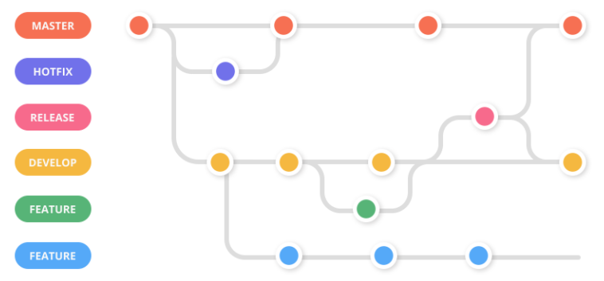
Git Workflows
Gitflow
It is an alternative branching model that involves the use of feature branches and multiple primary branches. Gitflow is a legacy Git workflow that has fallen in popularity in favor of trunk-based workflows, which are now considered best practices for modern continuous software development and DevOps practices.
Notes:
https://www.atlassian.com/git/tutorials/comparing-workflows/gitflow-workflow

Slide 48
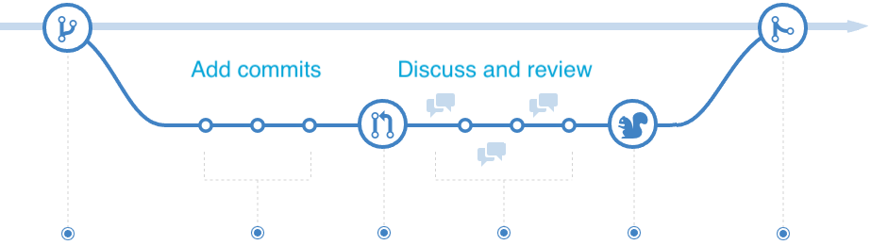
Git Workflows
GitHub flow
It is a lightweight, branch-based workflow that supports teams and projects where deployments are made regularly. It is a workflow designed to work well with GitHub using the following steps: 1) Create a new branch; 2) Make changes and add commits; 3) Open a Pull Request; 4) Review; 5) Deploy; 6) Merge
Notes:
Feature is deployed into an env and tested then merged
https://guides.github.com/introduction/flow/ https://www.w3schools.com/git/git_github_flow.asp

Slide 49
How do we use git?

Slide 50
Git 101
What does this process look like?
Process
Clone the repository
Make code changes
Stage your changes
Commit your changes
Push your changes
Commands
git clone
git add
git commit
git push

Slide 51
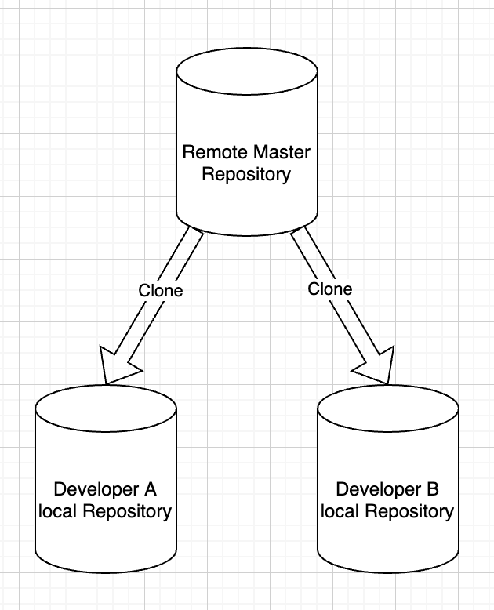
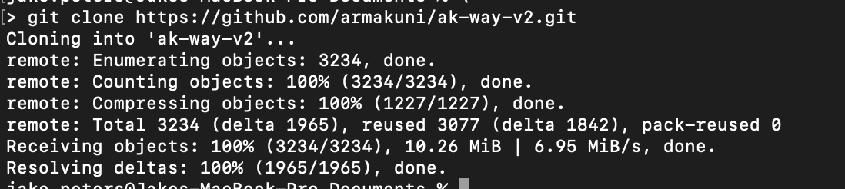
Git 101
Clone
git clone is a Git command line utility which is used to target an existing repository and create a clone, or copy of the target repository.
Notes:
git clone is primarily used to point to an existing repo and make a clone or copy of that repo at in a new directory, at another location. The original repository can be located on the local filesystem or on remote machine accessible supported protocols. The git clone command copies an existing Git repository.

Slide 52
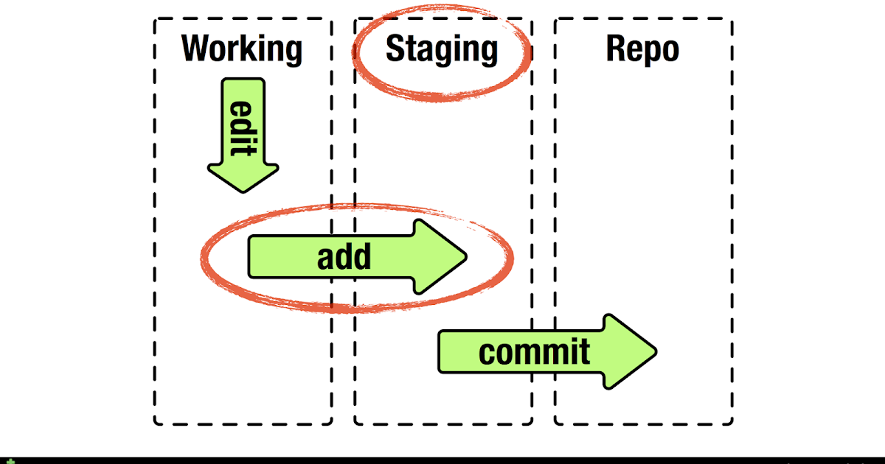
Git 101
Stage
The staging area sits between your working directory and your local repository
Notes:
Git staging area, it’s a way to prepare a commit without having to include every change in the working directory. This lets you create highly focused commits, even if you’ve made a lot of local changes.

Slide 53
Git 101
Stage
The staging area exists between your working directory and the local repository
As you edit files, Git sees them as modified. As you work, you selectively stage these modified files and then commit all those staged changes
Notes:
Git staging area, it’s a way to prepare a commit without having to include every change in the working directory. This lets you create highly focused commits, even if you’ve made a lot of local changes.

Slide 54
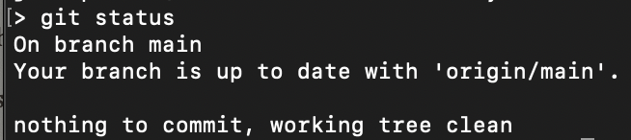
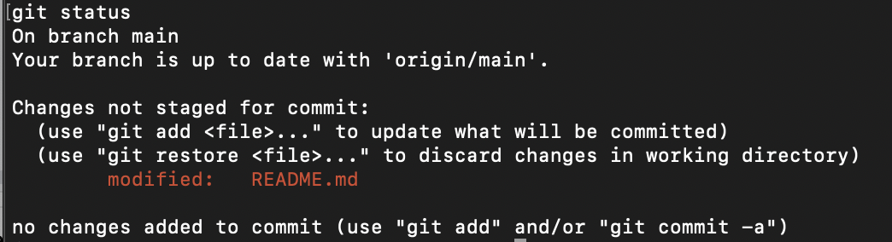
Git 101
Stage
The staging area exists between your working directory and the local repository
As you edit files, Git sees them as modified. As you work, you selectively stage these modified files and then commit all those staged changes
You can use git status command to check if your files have been modified
Working directory without any changes
Working directory with changes
Notes:
Git staging area, it’s a way to prepare a commit without having to include every change in the working directory. This lets you create highly focused commits, even if you’ve made a lot of local changes.
Useful analogy
Imagine a box. You can put stuff into the box. You can take stuff out of the box. This box is the staging area of Git. You can craft commits here. Committing is like sealing that box and sticking a label on it. The contents of that box are your changes. So, why not have the label mean something? You wouldn’t label a moving box with kitchen items as simply “stuff.”
As you make changes locally, Git can "see" them. However, figuratively speaking, they're out of the box. If you were to try and make a commit at this point, Git wouldn't have anything to commit.

Slide 55
Git 101
Stage
The staging area exists between your working directory and the local repository
As you edit files, Git sees them as modified. As you work, you selectively stage these modified files and then commit all those staged changes
You can use git status command to check if your files have been modified
Use git add command to stage files
Working directory without any changes
Working directory with changes
Notes:
Git staging area, it’s a way to prepare a commit without having to include every change in the working directory. This lets you create highly focused commits, even if you’ve made a lot of local changes.
Useful analogy
Imagine a box. You can put stuff into the box. You can take stuff out of the box. This box is the staging area of Git. You can craft commits here. Committing is like sealing that box and sticking a label on it. The contents of that box are your changes. So, why not have the label mean something? You wouldn’t label a moving box with kitchen items as simply “stuff.”
As you make changes locally, Git can "see" them. However, figuratively speaking, they're out of the box. If you were to try and make a commit at this point, Git wouldn't have anything to commit.

Slide 56
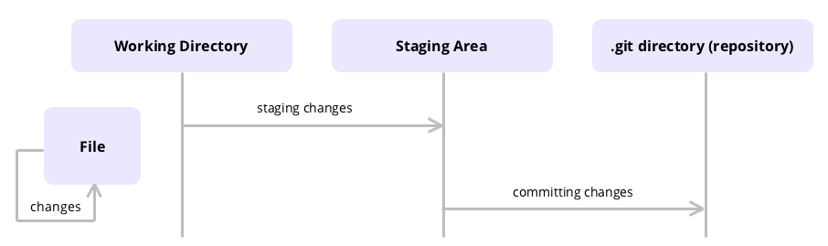
Git 101
Commit
Commit is a term used for recording changes to the the local repository

Slide 57
Git 101
Commit
Commit is a term used for recording changes to the the local repository
Git does not add changes to a commit automatically

Slide 58
Git 101
Commit
Commit is a term used for recording changes to the the local repository
Git does not add changes to a commit automatically
You need to indicate which file and changes need to be saved before running the git commit command

Slide 59
Git 101
Commit
Commit is a term used for recording changes to the the local repository
Git does not add changes to a commit automatically
You need to indicate which file and changes need to be saved before running the git commit command
The commit command does not save changes in remote servers, only in the local repository of Git

Slide 60
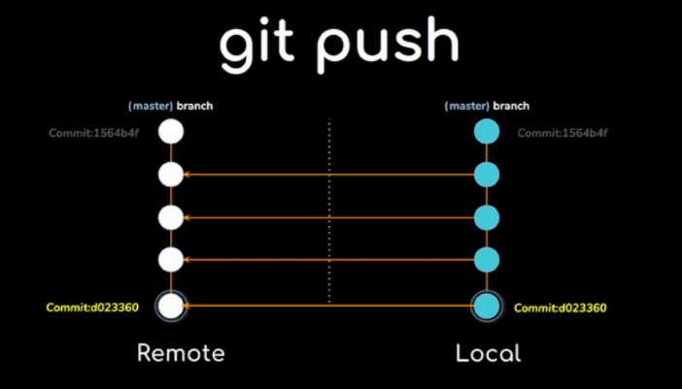
Git 101
Push
git push pushes your latest commits from your local repository to the remote one to share the modifications with other team members

Slide 61
Git 101
Push
git push pushes your latest commits from your local repository to the remote one to share the modifications with other team members
Pushing has the potential to overwrite changes, caution should be taken when pushing

Slide 62
Git 101
Recap
The Git committing process requires the following steps: moving changes to the staging area and saving them with the commit command
Process
Clone the repository
Make code changes
Stage your changes
Commit your changes
Push your changes
Commands
git clone
git add
git commit
git push
Notes:
The Git committing process requires several steps: moving changes to the staging area and saving them with the commit command.
Once you move the changes to the local repository by using Git commit command, you can use Git push to transfer them to a remote repository

Slide 63
Git 101
Recap
The Git committing process requires the following steps: moving changes to the staging area and saving them with the commit command
Once you move the changes to the local repository by using git commit command, you can use git push to transfer them to a remote repository
Process
Clone the repository
Make code changes
Stage your changes
Commit your changes
Push your changes
Commands
git clone
git add
git commit
git push
Notes:
The Git committing process requires several steps: moving changes to the staging area and saving them with the commit command.
Once you move the changes to the local repository by using Git commit command, you can use Git push to transfer them to a remote repository

Slide 64
Let’s do it!

Slide 65
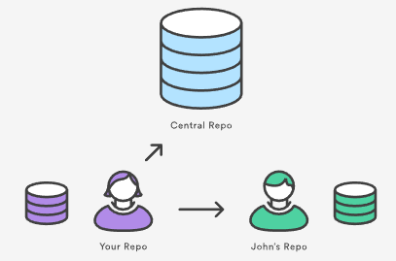
Git’s More Advanced Operations
Syncing
Git implements a broader system to sync changes across repos. Records (remote repo names) registered through the git remote command are used in conjunction with the git fetch, git push, and git pull commands. These commands all have their own syncing responsibilities which we are going to explore on this section.
Notes:
https://www.atlassian.com/git/tutorials/syncing
SVN uses a single centralized repository to serve as the communication hub for developers, and collaboration takes place by passing changesets between the developers’ working copies and the central repository. This is different from Git's distributed collaboration model, which gives every developer their own copy of the repository, complete with its own local history and branch structure. Users typically need to share a series of commits rather than a single changeset. Instead of committing a changeset from a working copy to the central repository, Git lets you share entire branches between repositories.

Slide 66
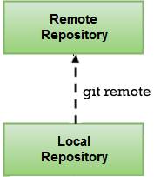



Git’s More Advanced Operations
Remote
The git remote command lets you create, view, and delete connections to other repositories. Remote connections are more like bookmarks rather than direct links into other repositories.
List the remote connections you have to other repositories:
Create a new connection to a remote repository:
Remove the connection to the remote repository called ＜name＞:
Rename a remote connection from ＜old-name＞ to ＜new-name＞:
Notes:
https://www.atlassian.com/git/tutorials/syncing
Git remote discussion
Git is designed to give each developer an entirely isolated development environment. This means that information is not automatically passed back and forth between repositories. Instead, developers need to manually pull upstream commits into their local repository or manually push their local commits back up to the central repository. The git remote command is really just an easier way to pass URLs to these "sharing" commands.
The origin Remote
When you clone a repository with git clone, it automatically creates a remote connection called origin pointing back to the cloned repository. This is useful for developers creating a local copy of a central repository, since it provides an easy way to pull upstream changes or publish local commits. This behavior is also why most Git-based projects call their central repository origin.
Repository URLs
Git supports many ways to reference a remote repository. Two of the easiest ways to access a remote repo are via the HTTP and the SSH protocols. HTTP is an easy way to allow anonymous, read-only access to a repository. For example:
http://host/path/to/repo.git
But, it’s generally not possible to push commits to an HTTP address (you wouldn’t want to allow anonymous pushes anyways). For read-write access, you should use SSH instead:
ssh://user@host/path/to/repo.git
You’ll need a valid SSH account on the host machine, but other than that, Git supports authenticated access via SSH out of the box. Modern secure 3rd party hosting solutions like Bitbucket.com will provide these URLs for you.

Slide 67
Exercise
Remote
Create a directory and navigate in there: mkdir vcs-lab && cd vcs-lab Initialise this directory as a git repo: git init
Connect the newly-created local repo to a remote one whilst defining an alias: git remote add origin https://github.com/jakepeters199/bn-osf-vcs.git
List the remote repo(s) connected to this repo: git remote -v
Notes:
https://www.atlassian.com/git/tutorials/syncing
Git remote discussion
Git is designed to give each developer an entirely isolated development environment. This means that information is not automatically passed back and forth between repositories. Instead, developers need to manually pull upstream commits into their local repository or manually push their local commits back up to the central repository. The git remote command is really just an easier way to pass URLs to these "sharing" commands.
The origin Remote
When you clone a repository with git clone, it automatically creates a remote connection called origin pointing back to the cloned repository. This is useful for developers creating a local copy of a central repository, since it provides an easy way to pull upstream changes or publish local commits. This behavior is also why most Git-based projects call their central repository origin.
Repository URLs
Git supports many ways to reference a remote repository. Two of the easiest ways to access a remote repo are via the HTTP and the SSH protocols. HTTP is an easy way to allow anonymous, read-only access to a repository. For example:
http://host/path/to/repo.git
But, it’s generally not possible to push commits to an HTTP address (you wouldn’t want to allow anonymous pushes anyways). For read-write access, you should use SSH instead:
ssh://user@host/path/to/repo.git
You’ll need a valid SSH account on the host machine, but other than that, Git supports authenticated access via SSH out of the box. Modern secure 3rd party hosting solutions like Bitbucket.com will provide these URLs for you.

Slide 68
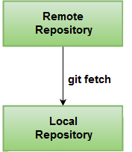
Git’s More Advanced Operations
Fetch
The git fetch command downloads commits, files, and refs from a remote repository into your local repo. Fetching is what you do when you want to see what everybody else has been working on.
Notes:
https://www.atlassian.com/git/tutorials/syncing/git-fetch
When downloading content from a remote repo, git pull and git fetch commands are available to accomplish the task. You can consider git fetch the 'safe' version of the two commands. It will download the remote content but not update your local repo's working state, leaving your current work intact. git pull is the more aggressive alternative; it will download the remote content for the active local branch and immediately execute git merge to create a merge commit for the new remote content. If you have pending changes in progress this will cause conflicts and kick-off the merge conflict resolution flow.

Slide 69
Git’s More Advanced Operations
Fetch
The git fetch command downloads commits, files, and refs from a remote repository into your local repo. Fetching is what you do when you want to see what everybody else has been working on.
Git isolates fetched content from existing local content; it has absolutely no effect on your local development work. Fetched content has to be explicitly checked out using the git checkout command. This makes fetching a safe way to review commits before integrating them with your local repository.
Notes:
https://www.atlassian.com/git/tutorials/syncing/git-fetch
Git fetch commands and options
git fetch <remote>
Fetch all of the branches from the repository. This also downloads all of the required commits and files from the other repository.
git fetch <remote> <branch>
Same as the above command, but only fetch the specified branch.
git fetch --all
A power move which fetches all registered remotes and their branches:
git fetch --dry-run
The --dry-run option will perform a demo run of the command. It will output examples of actions it will take during the fetch but not apply them.

Slide 70
Exercise
Fetch
Download the content from the remote repo to your local repo without changing the content of the current directory (working copy): git fetch origin Verify the directory is still empty: ls -lsa
Merge the content from the local repo into your current directory:
git merge origin/main
Verify the directory now contains the content from the remote repo: ls -lsa
Notes:
https://www.atlassian.com/git/tutorials/syncing
Git remote discussion
Git is designed to give each developer an entirely isolated development environment. This means that information is not automatically passed back and forth between repositories. Instead, developers need to manually pull upstream commits into their local repository or manually push their local commits back up to the central repository. The git remote command is really just an easier way to pass URLs to these "sharing" commands.
The origin Remote
When you clone a repository with git clone, it automatically creates a remote connection called origin pointing back to the cloned repository. This is useful for developers creating a local copy of a central repository, since it provides an easy way to pull upstream changes or publish local commits. This behavior is also why most Git-based projects call their central repository origin.
Repository URLs
Git supports many ways to reference a remote repository. Two of the easiest ways to access a remote repo are via the HTTP and the SSH protocols. HTTP is an easy way to allow anonymous, read-only access to a repository. For example:
http://host/path/to/repo.git
But, it’s generally not possible to push commits to an HTTP address (you wouldn’t want to allow anonymous pushes anyways). For read-write access, you should use SSH instead:
ssh://user@host/path/to/repo.git
You’ll need a valid SSH account on the host machine, but other than that, Git supports authenticated access via SSH out of the box. Modern secure 3rd party hosting solutions like Bitbucket.com will provide these URLs for you.

Slide 71
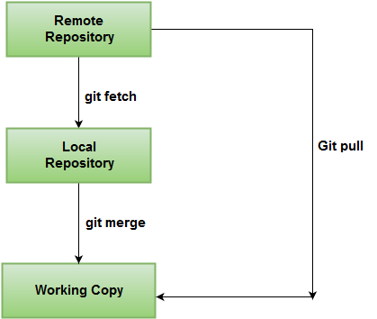
Git’s More Advanced Operations
Pull
The git pull command is used to fetch and download content from a remote repository and immediately update the local repository to match that content. It is actually a combination of two other commands, git fetch followed by git merge.
Notes:
https://www.atlassian.com/git/tutorials/syncing/git-pull
The git pull command first runs git fetch which downloads content from the specified remote repository. Then a git merge is executed to merge the remote content refs and heads into a new local merge commit. To better demonstrate the pull and merging process let us consider the following example. Assume we have a repository with a main branch and a remote origin.
You can think of git pull as Git's version of svn update. It’s an easy way to synchronize your local repository with upstream changes.

Slide 72
Git’s More Advanced Operations
Pull
The git pull command is used to fetch and download content from a remote repository and immediately update the local repository to match that content. It is actually a combination of two other commands, git fetch followed by git merge.
In the first stage of operation git pull will execute a git fetch scoped to the local branch that HEAD is pointed at.
Notes:
https://www.atlassian.com/git/tutorials/syncing/git-pull
The git fetch command can be confused with git pull. They are both used to download remote content. An important safety distinction can be made between git pull and get fetch. git fetch can be considered the "safe" option whereas, git pull can be considered unsafe. git fetch will download the remote content and not alter the state of the local repository. Alternatively, git pull will download remote content and immediately attempt to change the local state to match that content. This may unintentionally cause the local repository to get in a conflicted state.
The git fetch command can be confused with git pull. They are both used to download remote content. An important safety distinction can be made between git pull and get fetch. git fetch can be considered the "safe" option whereas, git pull can be considered unsafe. git fetch will download the remote content and not alter the state of the local repository. Alternatively, git pull will download remote content and immediately attempt to change the local state to match that content. This may unintentionally cause the local repository to get in a conflicted state.

Slide 73
Git’s More Advanced Operations
Pull
The git pull command is used to fetch and download content from a remote repository and immediately update the local repository to match that content. It is actually a combination of two other commands, git fetch followed by git merge.
In the first stage of operation git pull will execute a git fetch scoped to the local branch that HEAD is pointed at.
Once the content is downloaded, git pull will enter a merge workflow. A new merge commit will be-created and HEAD updated to point at the new commit.
Notes:
https://www.atlassian.com/git/tutorials/syncing/git-pull

Slide 74
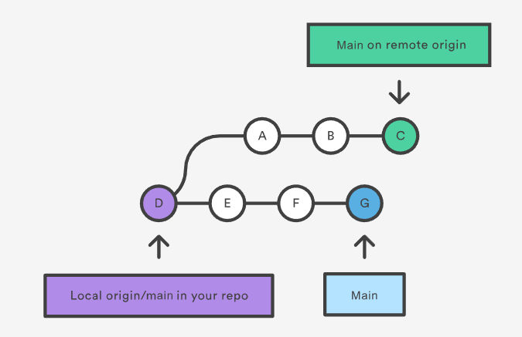
Git’s More Advanced Operations
Pulling
To better demonstrate the pull and merging process let us consider the following example. Assume we have a repository with a main branch and a remote origin.
Notes:
https://www.atlassian.com/git/tutorials/syncing/git-pull
Pulling via Rebase
The --rebase option can be used to ensure a linear history by preventing unnecessary merge commits. Many developers prefer rebasing over merging, since it’s like saying, "I want to put my changes on top of what everybody else has done." In this sense, using git pull with the --rebase flag is even more like svn update than a plain git pull.
In fact, pulling with --rebase is such a common workflow that there is a dedicated configuration option for it:
git config --global branch.autosetuprebase always
After running that command, all git pull commands will integrate via git rebase instead of git merge.

Slide 75
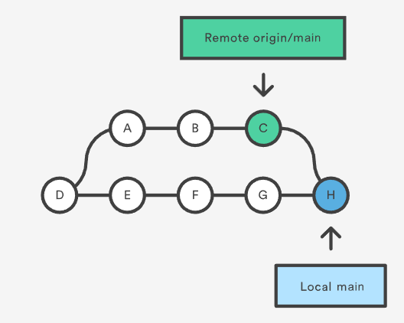
Git’s More Advanced Operations
Pulling
To better demonstrate the pull and merging process let us consider the following example. Assume we have a repository with a main branch and a remote origin.
Git pull will fetch the diverged remote commits which are A-B-C. The pull process will then create a new local merge commit H containing the content of the new diverged remote commits.
Notes:
https://www.atlassian.com/git/tutorials/syncing/git-pull
Pulling via Rebase
The --rebase option can be used to ensure a linear history by preventing unnecessary merge commits. Many developers prefer rebasing over merging, since it’s like saying, "I want to put my changes on top of what everybody else has done." In this sense, using git pull with the --rebase flag is even more like svn update than a plain git pull.
In fact, pulling with --rebase is such a common workflow that there is a dedicated configuration option for it:
git config --global branch.autosetuprebase always
After running that command, all git pull commands will integrate via git rebase instead of git merge.

Slide 76
Git’s More Advanced Operations
Pulling via Rebase
A --rebase option can be passed to git pull to use a rebase merging strategy instead of a merge commit. Assume that we are at a starting point of our diagram on the left, and we have executed git pull --rebase.
Notes:
https://www.atlassian.com/git/tutorials/syncing/git-pull
Pulling via Rebase
The --rebase option can be used to ensure a linear history by preventing unnecessary merge commits. Many developers prefer rebasing over merging, since it’s like saying, "I want to put my changes on top of what everybody else has done." In this sense, using git pull with the --rebase flag is even more like svn update than a plain git pull.
In fact, pulling with --rebase is such a common workflow that there is a dedicated configuration option for it:
git config --global branch.autosetuprebase always
After running that command, all git pull commands will integrate via git rebase instead of git merge.

Slide 77
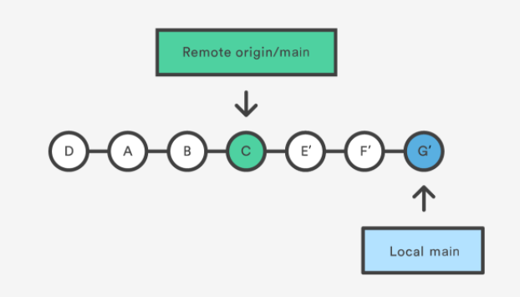
Git’s More Advanced Operations
Pulling via Rebase
A --rebase option can be passed to git pull to use a rebase merging strategy instead of a merge commit. Assume that we are at a starting point of our diagram on the left, and we have executed git pull --rebase.
We can see that a rebase pull does not create the new commit. Instead, the rebase has copied the remote commits A--B--C and rewritten the local commits E--F--G to appear after them in the local origin/main commit history.
Notes:
https://www.atlassian.com/git/tutorials/syncing/git-pull
Pulling via Rebase
The --rebase option can be used to ensure a linear history by preventing unnecessary merge commits. Many developers prefer rebasing over merging, since it’s like saying, "I want to put my changes on top of what everybody else has done." In this sense, using git pull with the --rebase flag is even more like svn update than a plain git pull.
In fact, pulling with --rebase is such a common workflow that there is a dedicated configuration option for it:
git config --global branch.autosetuprebase always
After running that command, all git pull commands will integrate via git rebase instead of git merge.

Slide 78
Exercise
Pulling via Rebase
Rebase your local repo to point to the latest content from the remote repo: git pull origin main --rebase
List all your branches (local and remote): git branch -a
Notes:
https://www.atlassian.com/git/tutorials/syncing
Git remote discussion
Git is designed to give each developer an entirely isolated development environment. This means that information is not automatically passed back and forth between repositories. Instead, developers need to manually pull upstream commits into their local repository or manually push their local commits back up to the central repository. The git remote command is really just an easier way to pass URLs to these "sharing" commands.
The origin Remote
When you clone a repository with git clone, it automatically creates a remote connection called origin pointing back to the cloned repository. This is useful for developers creating a local copy of a central repository, since it provides an easy way to pull upstream changes or publish local commits. This behavior is also why most Git-based projects call their central repository origin.
Repository URLs
Git supports many ways to reference a remote repository. Two of the easiest ways to access a remote repo are via the HTTP and the SSH protocols. HTTP is an easy way to allow anonymous, read-only access to a repository. For example:
http://host/path/to/repo.git
But, it’s generally not possible to push commits to an HTTP address (you wouldn’t want to allow anonymous pushes anyways). For read-write access, you should use SSH instead:
ssh://user@host/path/to/repo.git
You’ll need a valid SSH account on the host machine, but other than that, Git supports authenticated access via SSH out of the box. Modern secure 3rd party hosting solutions like Bitbucket.com will provide these URLs for you.

Slide 79
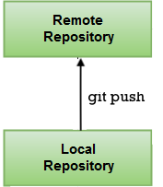
Git’s More Advanced Operations
Push
The git push command is used to upload local repository content to a remote repository. Pushing is how you transfer commits from your local repository to a remote repo.
Notes:
https://www.atlassian.com/git/tutorials/syncing/git-push
Git push usage
git push <remote> <branch>
Push the specified branch to , along with all of the necessary commits and internal objects. This creates a local branch in the destination repository. To prevent you from overwriting commits, Git won’t let you push when it results in a non-fast-forward merge in the destination repository.
git push <remote> --force
Same as the above command, but force the push even if it results in a non-fast-forward merge. Do not use the --force flag unless you’re absolutely sure you know what you’re doing.
git push <remote> --all
Push all of your local branches to the specified remote.
git push <remote> --tags
Tags are not automatically pushed when you push a branch or use the --all option. The --tags flag sends all of your local tags to the remote repository.

Slide 80
Git’s More Advanced Operations
Push
The git push command is used to upload local repository content to a remote repository. Pushing is how you transfer commits from your local repository to a remote repo.
It's the counterpart to git fetch, but whereas fetching imports commits to local branches, pushing exports commits to remote branches. Remote branches are configured using the git remote command.
Notes:
https://www.atlassian.com/git/tutorials/syncing/git-push
Git push usage
git push <remote> <branch>
Push the specified branch to , along with all of the necessary commits and internal objects. This creates a local branch in the destination repository. To prevent you from overwriting commits, Git won’t let you push when it results in a non-fast-forward merge in the destination repository.
git push <remote> --force
Same as the above command, but force the push even if it results in a non-fast-forward merge. Do not use the --force flag unless you’re absolutely sure you know what you’re doing.
git push <remote> --all
Push all of your local branches to the specified remote.
git push <remote> --tags
Tags are not automatically pushed when you push a branch or use the --all option. The --tags flag sends all of your local tags to the remote repository.

Slide 81
Git’s More Advanced Operations
Push
The git push command is used to upload local repository content to a remote repository. Pushing is how you transfer commits from your local repository to a remote repo.
It's the counterpart to git fetch, but whereas fetching imports commits to local branches, pushing exports commits to remote branches. Remote branches are configured using the git remote command.
Pushing has the potential to overwrite changes, caution should be taken when pushing.
Notes:
https://www.atlassian.com/git/tutorials/syncing/git-push
Git push usage
git push <remote> <branch>
Push the specified branch to , along with all of the necessary commits and internal objects. This creates a local branch in the destination repository. To prevent you from overwriting commits, Git won’t let you push when it results in a non-fast-forward merge in the destination repository.
git push <remote> --force
Same as the above command, but force the push even if it results in a non-fast-forward merge. Do not use the --force flag unless you’re absolutely sure you know what you’re doing.
git push <remote> --all
Push all of your local branches to the specified remote.
git push <remote> --tags
Tags are not automatically pushed when you push a branch or use the --all option. The --tags flag sends all of your local tags to the remote repository.

Slide 82
Exercise
Push
Check out the main branch from your local repo onto the working directory: git checkout main Add a new file to the repo replacing YOUR-NAME, first and last names: echo “YOUR NAME” > first_name-last_name.txt
git add first_name-last.name.txt
git commit -am “YOUR NAME’s commit”
Verify the local repo’s status: git status
Upload your local repo to the remote repo: git push
Notes:
https://www.atlassian.com/git/tutorials/syncing
Git remote discussion
Git is designed to give each developer an entirely isolated development environment. This means that information is not automatically passed back and forth between repositories. Instead, developers need to manually pull upstream commits into their local repository or manually push their local commits back up to the central repository. The git remote command is really just an easier way to pass URLs to these "sharing" commands.
The origin Remote
When you clone a repository with git clone, it automatically creates a remote connection called origin pointing back to the cloned repository. This is useful for developers creating a local copy of a central repository, since it provides an easy way to pull upstream changes or publish local commits. This behavior is also why most Git-based projects call their central repository origin.
Repository URLs
Git supports many ways to reference a remote repository. Two of the easiest ways to access a remote repo are via the HTTP and the SSH protocols. HTTP is an easy way to allow anonymous, read-only access to a repository. For example:
http://host/path/to/repo.git
But, it’s generally not possible to push commits to an HTTP address (you wouldn’t want to allow anonymous pushes anyways). For read-write access, you should use SSH instead:
ssh://user@host/path/to/repo.git
You’ll need a valid SSH account on the host machine, but other than that, Git supports authenticated access via SSH out of the box. Modern secure 3rd party hosting solutions like Bitbucket.com will provide these URLs for you.

Slide 83
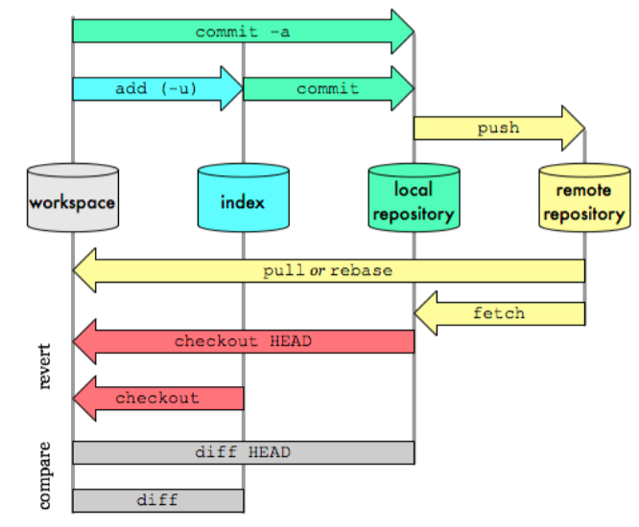
Git’s More Advanced Operations
Visualisation

Slide 84

‹#›

